Slide 1
Outdated design patterns
Jiří Pokorný

Slide 2
Jiri.Pokorny@SolarWinds.com
https://wug.cz/prednasejici/4-Jiri-Pokorny
https://github.com/jirkapok/Presentations
https://www.solarwinds.jobs/
Seniors: we are hiring!
Students: summer internship
Apply now to get the summer job

Slide 3
Motivation
Do design patterns evolve like frameworks?
Are we still using modern techniques?
Are there any obsolete design patterns?
Which patterns should I learn?
Patterns covered: basic, UI, architecture, cloud
Notes:
UI – meaning not UI design patterns (), but more user interaction patterns used to interact with the UI.
See https://fourweekmba.com/ui-design-pattern/

Slide 4
Singleton and Service locator
Situation: Low test-ability, unable to remove cached data,
Warning: Not easy to implement thread safe!
Replacement: Inversion of Control (IoC)
IoC still implemented as service locator Please stop using public static!
// Before, deep inside some object …
ServiceLocator.Instance.Get<IMailSender>();
// After in Application root Main method
var kernel = new StandardKernel(); // Ninject IoC
kernel.Bind<IMailSender>().To<MailSender>();
var implementation = kernel.Get<IMailSender>();
Notes:
Both patterns are Still recommended on the internet as patterns you need to know.
https://csharpindepth.com/articles/singleton

Slide 5
Observer vs. Publish/Subscribe
Observer situation:
event - Need to unregister, when not needed (possible memory leak)
Not supporting async/await in dotnet
Improvements:
pub/sub implementations like MediatR for dotnet (IoC supported, Async/await with cancelation etc.)
rxJs subscription: use pipes instead
// Typescript before ...
const subscription = this.planner.tanksReloaded$.subscribe(() => this.reloadAll());
// ...
subscription.unsubscribe();
// after ... this.planner.tanksReloaded$.pipe(takeUntil(this.unsubscribe$))
.subscribe(() => this.reloadAll());
// ...
this.unsubscribe$.next();
Notes:
https://youtu.be/NmmpXcMxCjY
https://youtu.be/wDAmfqnIrck
https://www.youtube.com/watch?v=ejjln8hI14M
https://embeddedartistry.com/fieldatlas/differentiating-observer-and-publish-subscribe-patterns/
Difference: Observer knows the subscriber,
pub/sub has service between them, so they don’t know each other
For large systems: Kafka, rabbitMq etc.

Slide 6
State/State machine
Situation: stateless services (e.g. for docker) Still used internally e.g. In dotnet async/await
C# 7.2 – readonly references
static void ProcessStruct1(in ContainerStruct toModify) ...
ref readonly var result2 = ProcessStruct2(sut);
C# 8 – readonly struct
var sut = new ReadOnlyStruct("bbb");
// can't sut.Name = "aaa";
C# 9 – nullable reference types,
records, init setter
var record1 = new ReadOnlyRecordStruct("aaa");
var record2 = record1 with { Name = "bbb" };
Replacements: Are pointing to Immutable objects
Notes:
https://www.c-sharpcorner.com/article/all-about-c-sharp-immutable-classes2/
https://blog.ndepend.com/c9-records-immutable-classes/
https://learn.microsoft.com/en-us/dotnet/csharp/language-reference/proposals/csharp-8.0/readonly-instance-members
https://learn.microsoft.com/en-us/dotnet/csharp/language-reference/attributes/nullable-analysis
https://youtu.be/bXsOOpWavp4

Slide 7
UI design patterns
MVC x MVP x MVVM: What is the difference?
MVU: Model View Update
Adopted by community?
Introduced with dotnet MAUI
Promotes immutables
Functional aproach to UI updates
Still most technologies implement MVVM as newest pattern
Notes:
https://learn.microsoft.com/en-us/dotnet/architecture/maui/
http://billreiss.com/2021/08/06/net-maui-and-the-mvu-pattern/
https://thomasbandt.com/model-view-update
https://www.jmparent.com/2022/01/18/mvu-or-mvvm-with-maui-app/
https://www.youtube.com/watch?v=NftMKF9EpeM
https://dev.to/armandotrue/design-patterns-in-angular-part-i-3ld7
https://www.makeuseof.com/mvc-mvp-mvvm-which-choose/
https://elmprogramming.com/model-view-update-part-1.html
https://dev.to/davidortinau/comet-development-on-macos-1o38
https://github.com/dotnet/Comet
https://youtu.be/cdC7RrONYJE?list=PLfbOp004UaYWu-meDkRN6_Y1verl96npI

Slide 8
Anemic domain model - Antipattern?
Criticism by M. Fowler as antipattern:
Plain (e.g. Dto) objects don’t contain behavior (e.g. validation) and lack OOP principles
Usually when dealing with ORM mapping
80% of EF domain models are anemic
Defense: It provides Single responsibility principle
// before able to create invalid data
var anemicPost = new AnemicBlogPost();
anemicPost.Status = BlogPostStatus.Published;
// after
var post = new BlogPost("something", BlogPostStatus.Unknown);
post.Publish();
Notes:
https://en.wikipedia.org/wiki/Anemic_domain_model
https://codeopinion.com/is-an-anemic-domain-model-really-that-bad/
https://blog.codecentric.de/ddd-vs-anemic-domain-models
https://www.devtrends.co.uk/blog/3-ways-to-avoid-an-anemic-domain-model-in-ef-core
https://blog.devgenius.io/how-to-avoid-anemic-domain-model-59775c639678
https://dev.to/crovitz/have-you-anemic-or-rich-domain-model-2ala
EF – entity framework
ORM – object relation mapping
OOP – object oriented principles
Dto – data transfer objects

Slide 9
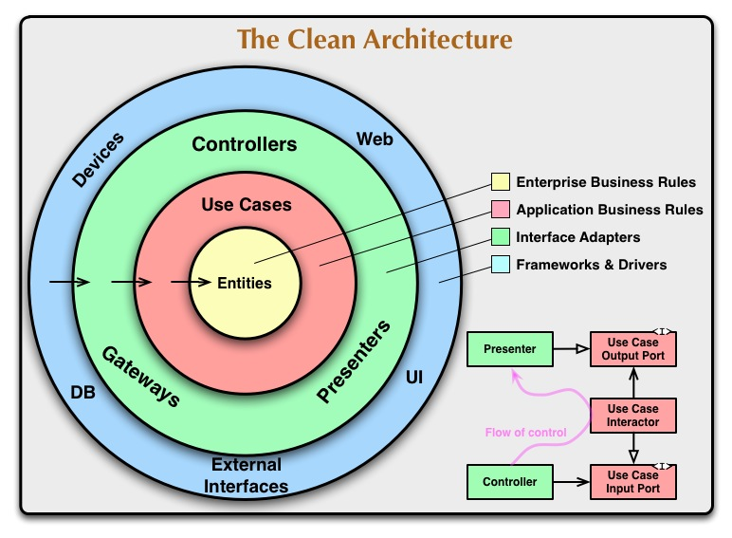
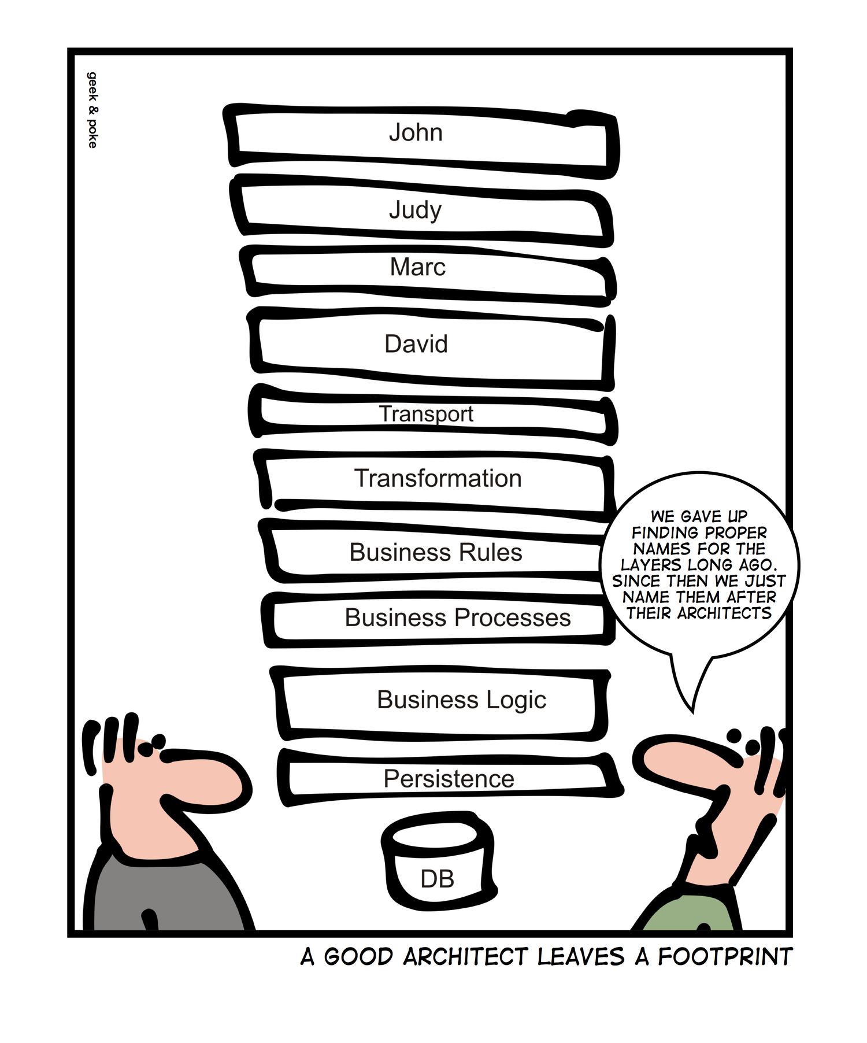
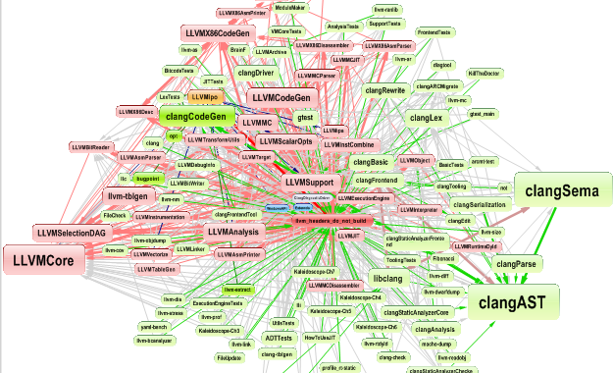
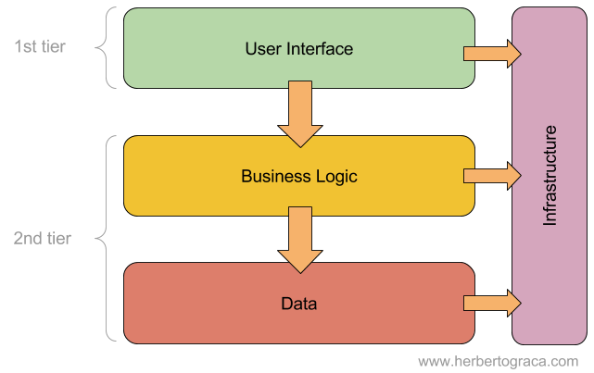
Layers – Theory vs. Reality
Lasagna, onions ...
Notes:
https://codeopinion.com/what-is-software-architecture/
https://codeopinion.com/restructuring-to-a-vertical-slice-architecture/
Picture sources:
https://www.cppdepend.com/Doc_VS_Arch
https://herbertograca.com/2017/08/03/layered-architecture/
https://blog.cleancoder.com/uncle-bob/2012/08/13/the-clean-architecture.html
https://geek-and-poke.com/geekandpoke/2013/7/13/foodprints

Slide 10
Fall down of Layers
Situation: Hard to replace components, hard to follow the layers
Sink hole antipattern Easy to learn?
Is not following agile practices: (slice per feature) Does not support feature toggling
Replaced by: IoC and microservices (hexagonal)
Notes:
https://www.coursehero.com/file/pc556e5/Architecture-Sinkhole-Anti-pattern-This-anti-pattern-describes-the-situation/

Slide 11
Layers – Modern alternative
Application 1
Application 2
FeaA
UI
BL
FeaB
UI
BL
FeaC
UI
BL
DAL
DAL
DAL
FeaD
FeaE
UI
BL
DAL
UI
BL
DAL
Notes:
https://youtu.be/L2Wnq0ChAIA
https://codeopinion.com/restructuring-to-a-vertical-slice-architecture/
Fea - feature

Slide 12
Exotic design patterns
Circuit Breaker
Event Sourcing
Sidecar
Backend-for-Frontend
Strangler
…
Aren’t they a combination of old patterns? Some
What drives new patterns? Cloud
Notes:
https://betterprogramming.pub/modern-day-architecture-design-patterns-for-software-professionals-9056ee1ed977
https://fabric.inc/blog/modern-design-patterns/
https://learn.microsoft.com/en-us/azure/architecture/patterns/
Circuit Breaker – Retry pattern variation, don’t run operation, which probably fails, used in microservices
Event Sourcing – append only store, add state history, for high performance and avoid synchronization problems
Sidecar – deploy components into separate process or container for isolation
Backend-for-Frontend – separate concrete services designed for each type of UI
Strangler – replace service parts using small increments, transparent to the consumer
CQRS – command query separation, isolate read/write operations

Slide 13
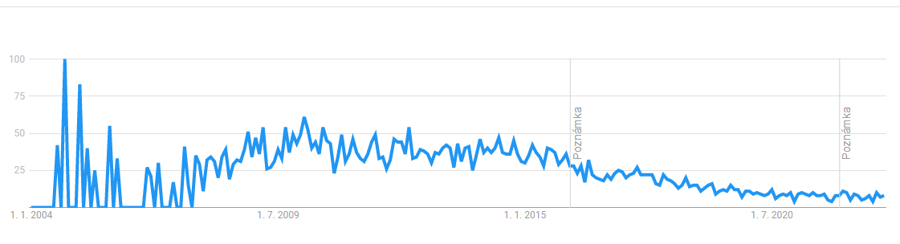
Aspect oriented programming (AOP)
No change in the field
Dynamic proxies still dominate (Castle)
PostSharp popularity by Google Statistics:
Notes:
https://opus.hs-furtwangen.de/frontdoor/deliver/index/docId/6761/file/Aspect-Oriented+Programming+Revisited+09.pdf
https://medium.com/swlh/thinking-beyond-roslyn-source-generators-and-aspect-oriented-programming-3e42d58c37ac
https://github.com/castleproject/Core/blob/master/docs/dynamicproxy.md

Slide 14
„May the source be with you“
Notes:
https://youtu.be/w9YhmMPLQ4U

